Slide 1
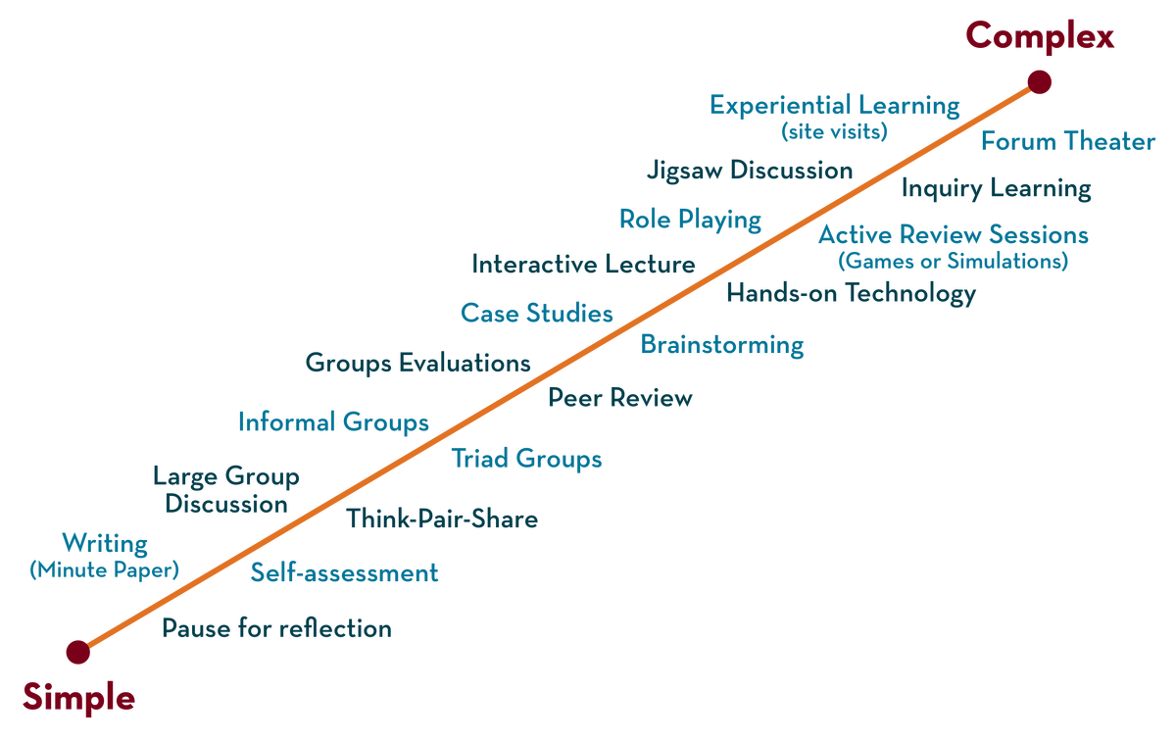
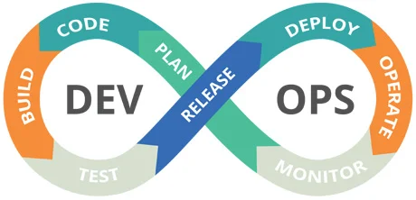

23sdcs13A/R
CI/CD and Cloud devops
Topic:
GitHub actions for ci/cd
Dr. suneetha Bulla

Slide 2
Git Actions

Slide 3
Git Actions
GitHub Actions is a continuous integration and continuous delivery (CI/CD) platform that allows you to automate your build, test, and deployment pipeline.
Create workflows that run tests whenever you push a change to your repository, or that deploy merged pull requests to production.
GitHub provides preconfigured workflow templates that you can use as-is or customize to create your own workflow.
GitHub analyzes your code and shows you workflow templates that might be useful for your repository.

Slide 4
GitActions Terminologies
Term | Meaning
Workflow | A YAML file that defines the automation process.
Job | A group of steps that run on the same machine.
Step | A single task, like installing Node.js or running a test.
Runner | The virtual machine (like Ubuntu or Windows) where jobs run.
Event | A trigger (like push, pull_request, or schedule) that starts a workflow.
Action | A prebuilt reusable piece of code (like actions/checkout) used in a step.
name | Friendly name for the workflow
on | Events that trigger the workflow (push, pull_request, schedule, etc.)
jobs | Groups of steps executed on a runner
runs-on | The environment (like ubuntu-latest, windows-latest)
uses | Reusable GitHub Action from Marketplace
run | Shell command to execute

Slide 5
Types of Workflow Templates
CI: Continuous Integration workflows
Deployments: Deployment workflows
Automation: Automating workflows
Code Scanning: Code Scanning workflows
Pages: Pages workflows

Slide 6
Workflow Basic Template of CI
name: Basic CI Workflow
on:
push:
branches: [main]
pull_request:
branches: [main]
jobs:
build:
runs-on: ubuntu-latest
steps:
- name: Checkout Repository
uses: actions/checkout@v4
- name: Set up Node.js
uses: actions/setup-node@v4
with:
node-version: '20'
- name: Install Dependencies
run: npm install
- name: Run Tests
run: npm test

Slide 7
Workflow Basic Template of CD
name: Deploy Website
on:
push:
branches:
- main # triggers when you push to main branch
jobs:
deploy:
runs-on: ubuntu-latest
steps:
- name: Checkout repository
uses: actions/checkout@v4
- name: Set up Node.js
uses: actions/setup-node@v4
with:
node-version: '20'
- name: Install dependencies
run: npm install
- name: Build the project
run: npm run build
- name: Deploy to GitHub Pages
uses: peaceiris/actions-gh-pages@v3
with:
github_token: ${{ secrets.GITHUB_TOKEN }}
publish_dir: ./build # Path to static files

